Slide 1
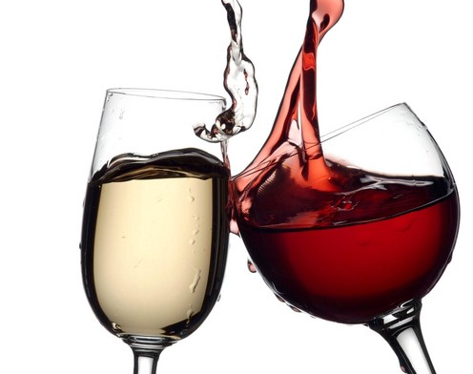
Wine Quality Prediction
By- Shubhangi Waghmare
Learnbay ML Capstone Project 1

Slide 2

Solution Process-
Data Preprocessing
Checked For Null Values, used correlation, heat map, pair plot to find important features for analysis.
Mapped Wine Quality Response to bad and good[(3,4,5):Bad],[(6,7,8):Good] and then converted it into binary 1:Good, 0:Bad.
Model Used
Decision Tree

Slide 3
Performance Report Of Model
 | Precision | Recall | F1-Score | Support
0 | 0.72 | 0.67 | 0.70 | 204
1 | 0.68 | 0.73 | 0.70 | 196
Accuracy |  |  | 0.70 | 400
Macro Avg | 0.70 | 0.70 | 0.70 | 400
Weighted Avg | 0.70 | 0.70 | 0.70 | 400
Created DT Model have Training accuracy-0.77 &
Testing accuracy-0.71

Slide 4

Error Rate =1-accuracy
=1-0.7
= 0.3
Confusion Matrix=[[137 67]
[53 143]]
Conclusion
As per Performance Report and Error Rate Decision Tree Wine Prediction Model gives 0.7 accurate predictions with error rate of 0.3

